Slide 1
Chapter 3: Transport Layer
Chapter goals:
understand principles behind transport layer services:
  multiplexing/demultiplexing
  reliable data transfer
  flow control
  congestion control
instantiation and implementation in the Internet
Chapter Overview:
transport layer services
multiplexing/demultiplexing
connectionless transport: UDP
principles of reliable data transfer
connection-oriented transport: TCP
  reliable transfer
  flow control
  connection management
principles of congestion control
TCP congestion control

Slide 2





Transport services and protocols
provide logical communication between app’ processes running on different hosts
transport protocols run in end systems
transport vs network layer services:
network layer: data transfer between end systems
transport layer: data transfer between processes
  relies on, enhances, network layer services
application
transport
network
data link
physical
network
data link
physical
network
data link
physical
network
data link
physical
logical end-end transport
network
data link
physical
network
data link
physical
application
transport
network
data link
physical

Slide 3
Transport-layer protocols
Internet transport services:
reliable, in-order unicast delivery (TCP)
  congestion
  flow control
  connection setup
unreliable (“best-effort”), unordered unicast or multicast delivery: UDP
services not available:
  real-time
  bandwidth guarantees
  reliable multicast
application
transport
network
data link
physical
network
data link
physical
network
data link
physical
network
data link
physical
logical end-end transport
network
data link
physical
network
data link
physical
application
transport
network
data link
physical

Slide 4
Multiplexing/demultiplexing
Recall: segment - unit of data exchanged between transport layer entities
  aka TPDU: transport protocol data unit
Demultiplexing: delivering
received segments to
correct app layer processes
receiver
P3
P4
application-layer
data
M
M
application
transport
network
segment
header
P1
P2
M
M
application
transport
network
application
transport
network
segment
H
t
M
H
segment
n

Slide 5
Multiplexing/demultiplexing
Multiplexing:
gathering data from multiple
app processes, enveloping
data with header (later used
for demultiplexing)
32 bits
source port #
dest port #
other header fields
multiplexing/demultiplexing:
based on sender, receiver port numbers, IP addresses
  source, dest port #s in each segment
  recall: well-known port numbers for specific applications
application
data
(message)
TCP/UDP segment format

Slide 6
Multiplexing/demultiplexing: examples
source port: x
dest. port: 23
Web client
host C
host A
server B
source port:23
dest. port: x
Source IP: C
Dest IP: B
source port: y
dest. port: 80
Source IP: C
Dest IP: B
source port: x
dest. port: 80
port use: simple telnet app
Source IP: A
Dest IP: B
source port: x
dest. port: 80
Web
server B
Web client
host A
port use: Web server

Slide 7
UDP: User Datagram Protocol [RFC 768]
“no frills,” “bare bones” Internet transport protocol
“best effort” service, UDP segments may be:
  lost
  delivered out of order to app
connectionless:
  no handshaking between UDP sender, receiver
  each UDP segment handled independently of others
Why is there a UDP?
no connection establishment (which can add delay)
simple: no connection state at sender, receiver
small segment header
no congestion control: UDP can blast away as fast as desired

Slide 8
UDP: more
often used for streaming multimedia apps
  loss tolerant
  rate sensitive
other UDP uses (why?):
  DNS
  SNMP
reliable transfer over UDP: add reliability at application layer
  application-specific error recover!
32 bits
Length, in
bytes of UDP
segment,
including
header
source port #
dest port #
length
checksum
Application
data
(message)
UDP segment format

Slide 9
UDP checksum
Goal: detect “errors” (e.g., flipped bits) in transmitted segment
Sender:
treat segment contents as sequence of 16-bit integers
checksum: addition (1’s complement sum) of segment contents
sender puts checksum value into UDP checksum field
Receiver:
compute checksum of received segment
check if computed checksum equals checksum field value:
  NO - error detected
  YES - no error detected. But maybe errors nonethless? More later ….

Slide 10

Principles of Reliable data transfer
important in app., transport, link layers
top-10 list of important networking topics!
characteristics of unreliable channel will determine complexity of reliable data transfer protocol (rdt)

Slide 11

Reliable data transfer: getting started
rdt_send(): called from above, (e.g., by app.). Passed data to
deliver to receiver upper layer
deliver_data(): called by rdt to deliver data to upper
send
side
receive
side
udt_send(): called by rdt,
to transfer packet over
unreliable channel to receiver
rdt_rcv(): called when packet arrives on rcv-side of channel

Slide 12
Reliable data transfer: getting started
We’ll:
incrementally develop sender, receiver sides of reliable data transfer protocol (rdt)
consider only unidirectional data transfer
  but control info will flow on both directions!
use finite state machines (FSM) to specify sender, receiver
event causing state transition
actions taken on state transition
state: when in this “state” next state uniquely determined by next event
state
1
state
2
event
actions

Slide 13
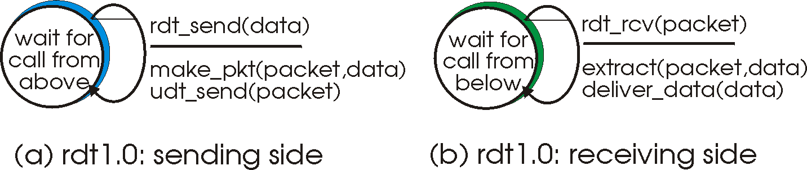
Rdt1.0: reliable transfer over a reliable channel
underlying channel perfectly reliable
  no bit erros
  no loss of packets
separate FSMs for sender, receiver:
  sender sends data into underlying channel
  receiver read data from underlying channel

Slide 14
Rdt2.0: channel with bit errors
underlying channel may flip bits in packet
  recall: UDP checksum to detect bit errors
the question: how to recover from errors:
  acknowledgements (ACKs): receiver explicitly tells sender that pkt received OK
  negative acknowledgements (NAKs): receiver explicitly tells sender that pkt had errors
  sender retransmits pkt on receipt of NAK
  human scenarios using ACKs, NAKs?
new mechanisms in rdt2.0 (beyond rdt1.0):
  error detection
  receiver feedback: control msgs (ACK,NAK) rcvr->sender

Slide 15
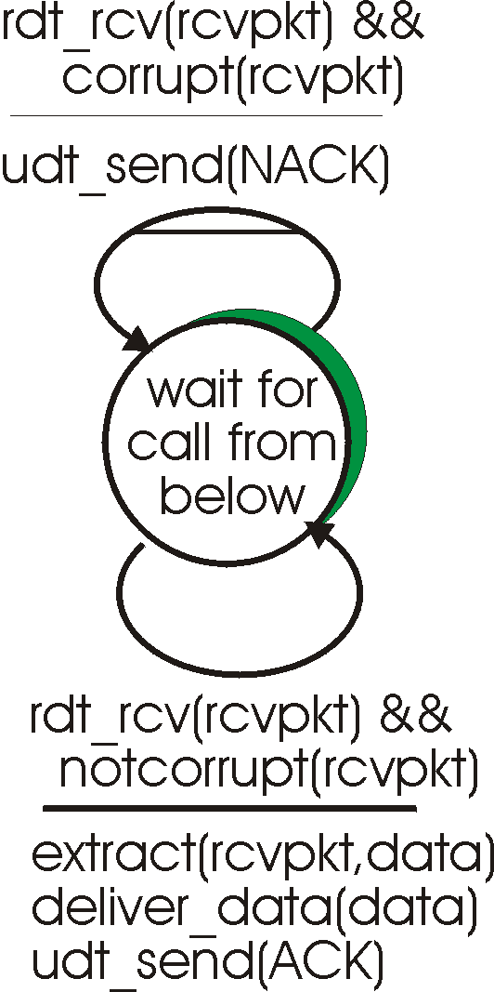
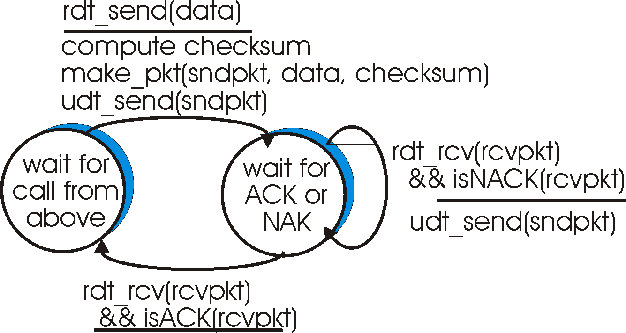
rdt2.0: FSM specification
sender FSM
receiver FSM

Slide 16
rdt2.0: in action (no errors)
sender FSM
receiver FSM

Slide 17
rdt2.0: in action (error scenario)
sender FSM
receiver FSM

Slide 18
rdt2.0 has a fatal flaw!
What happens if ACK/NAK corrupted?
sender doesn’t know what happened at receiver!
san’t just retransmit: possible duplicate
What to do?
sender ACKs/NAKs receiver’s ACK/NAK? What if sender ACK/NAK lost?
retransmit, but this might cause retransmission of correctly received pkt!
Handling duplicates:
sender adds sequence number to each pkt
sender retransmits current pkt if ACK/NAK garbled
receiver discards (doesn’t deliver up) duplicate pkt
stop and wait
Sender sends one packet,
then waits for receiver
response

Slide 19
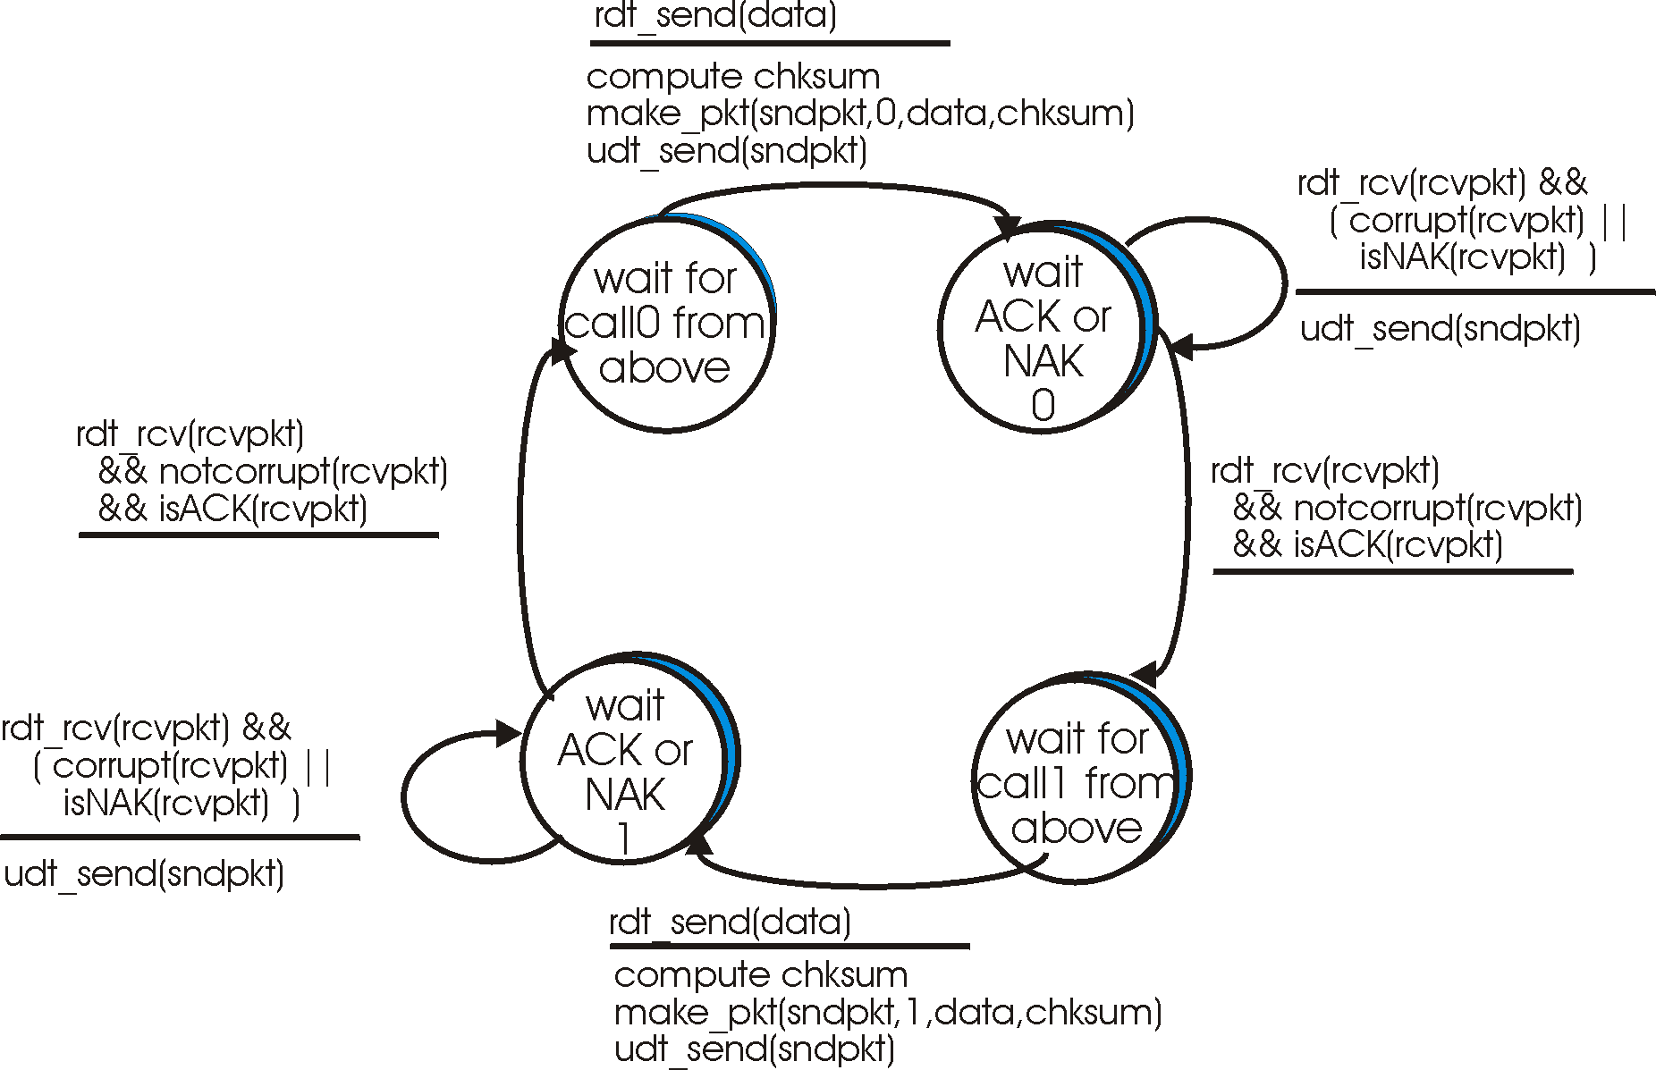
rdt2.1: sender, handles garbled ACK/NAKs

Slide 20
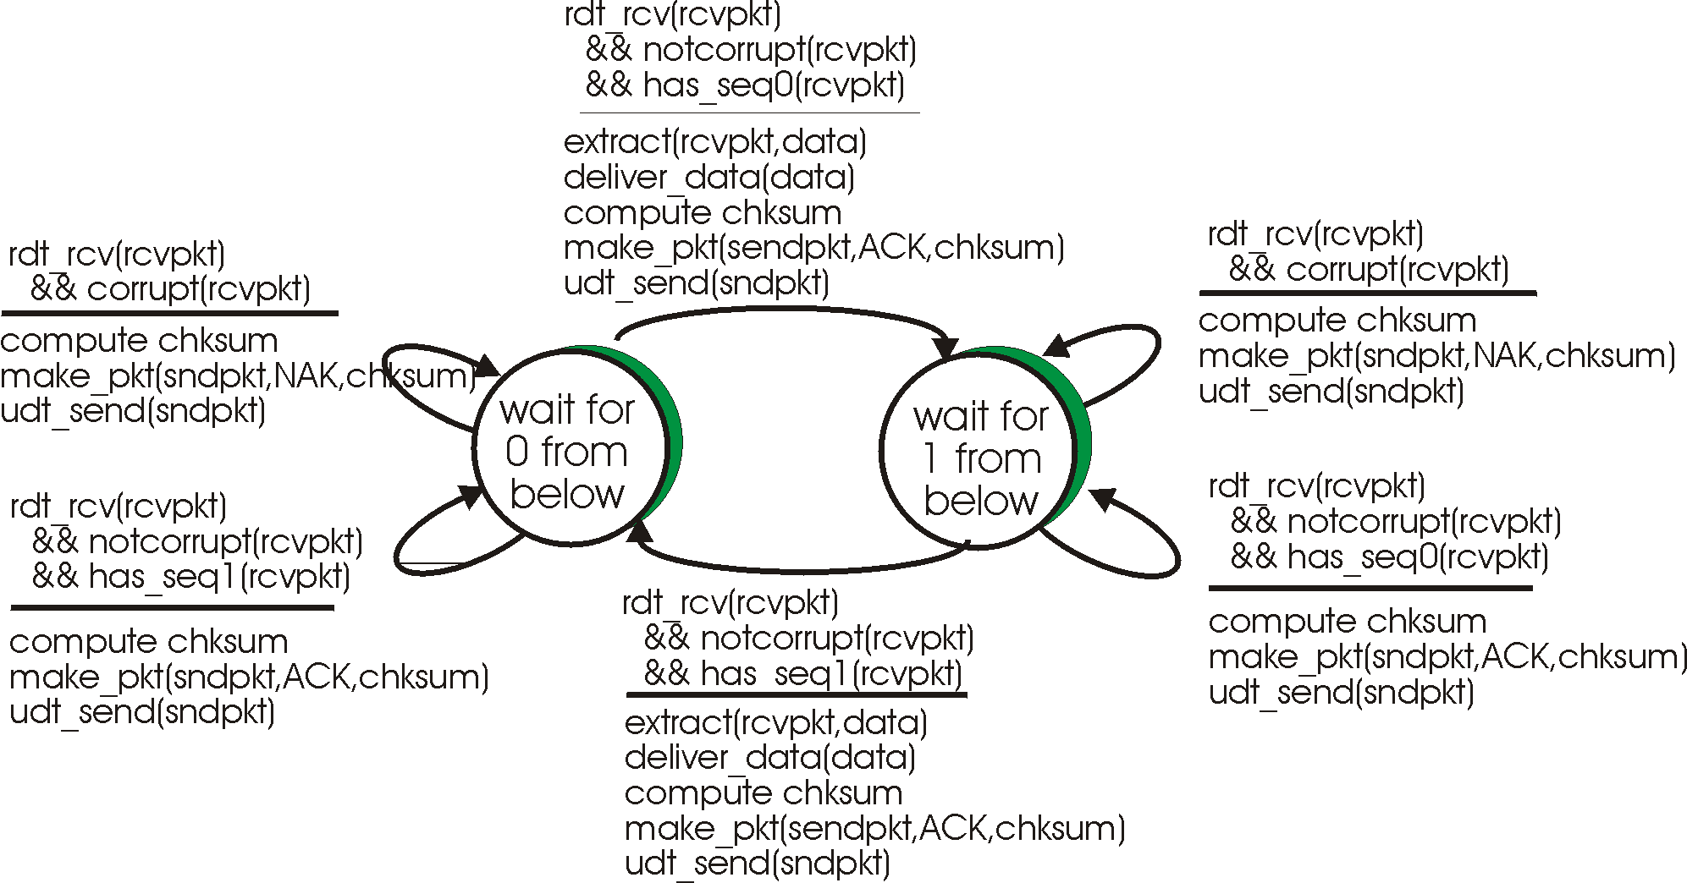
rdt2.1: receiver, handles garbled ACK/NAKs

Slide 21
rdt2.1: discussion
Sender:
seq # added to pkt
two seq. #’s (0,1) will suffice. Why?
must check if received ACK/NAK corrupted
twice as many states
  state must “remember” whether “current” pkt has 0 or 1 seq. #
Receiver:
must check if received packet is duplicate
  state indicates whether 0 or 1 is expected pkt seq #
note: receiver can not know if its last ACK/NAK received OK at sender

Slide 22
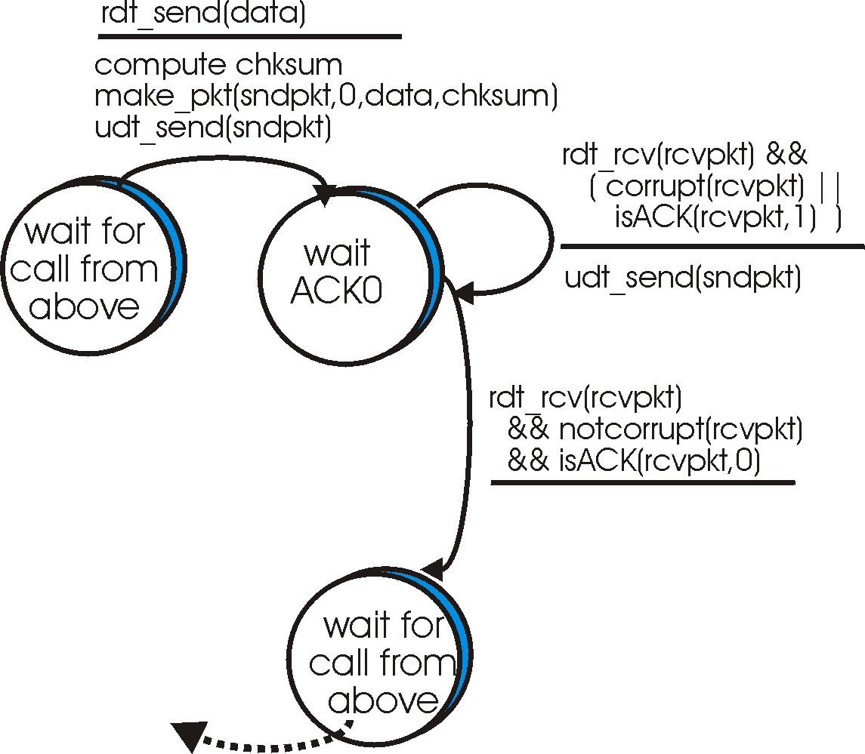
rdt2.2: a NAK-free protocol
sender
FSM
same functionality as rdt2.1, using NAKs only
instead of NAK, receiver sends ACK for last pkt received OK
  receiver must explicitly include seq # of pkt being ACKed
duplicate ACK at sender results in same action as NAK: retransmit current pkt
!

Slide 23
rdt3.0: channels with errors and loss
New assumption: underlying channel can also lose packets (data or ACKs)
  checksum, seq. #, ACKs, retransmissions will be of help, but not enough
Q: how to deal with loss?
  sender waits until certain data or ACK lost, then retransmits
  yuck: drawbacks?
Approach: sender waits “reasonable” amount of time for ACK
retransmits if no ACK received in this time
if pkt (or ACK) just delayed (not lost):
  retransmission will be duplicate, but use of seq. #’s already handles this
  receiver must specify seq # of pkt being ACKed
requires countdown timer

Slide 24
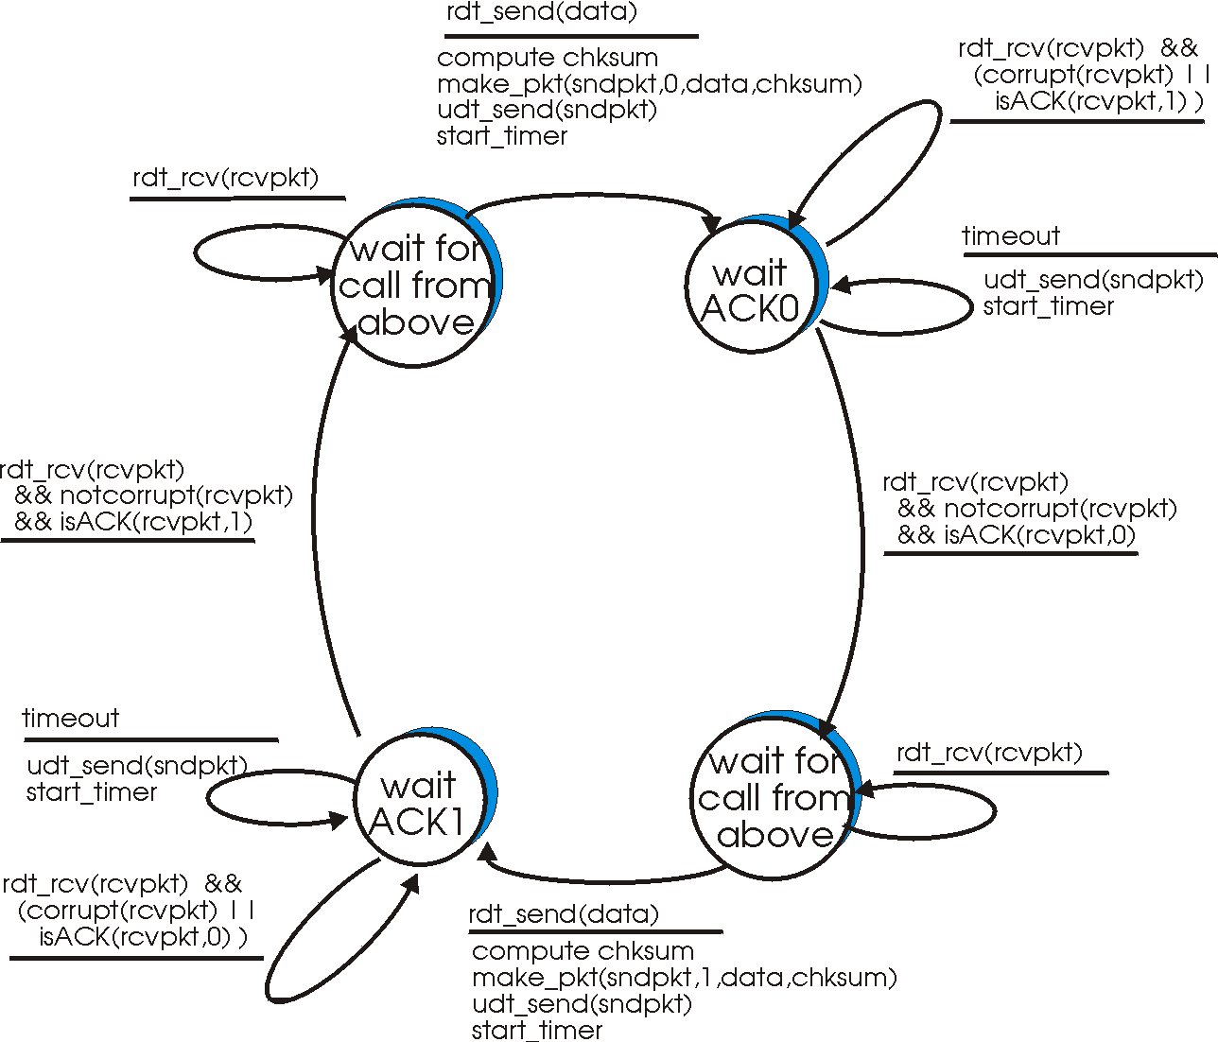
rdt3.0 sender

Slide 25

rdt3.0 in action

Slide 26

rdt3.0 in action

Slide 27
Performance of rdt3.0
rdt3.0 works, but performance stinks
example: 1 Gbps link, 15 ms e-e prop. delay, 1KB packet:
T
8kb/pkt
transmit
=
= 8 microsec
10**9 b/sec
fraction of time
sender busy sending
8 microsec
Utilization = U =
=
= 0.00015
30.016 msec
  1KB pkt every 30 msec -> 33kB/sec thruput over 1 Gbps link
  network protocol limits use of physical resources!

Slide 28

Pipelined protocols
Pipelining: sender allows multiple, “in-flight”, yet-to-be-acknowledged pkts
  range of sequence numbers must be increased
  buffering at sender and/or receiver
Two generic forms of pipelined protocols: go-Back-N, selective repeat

Slide 29

Go-Back-N
Sender:
k-bit seq # in pkt header
“window” of up to N, consecutive unack’ed pkts allowed
ACK(n): ACKs all pkts up to, including seq # n - “cumulative ACK”
  may deceive duplicate ACKs (see receiver)
timer for each in-flight pkt
timeout(n): retransmit pkt n and all higher seq # pkts in window

Slide 30
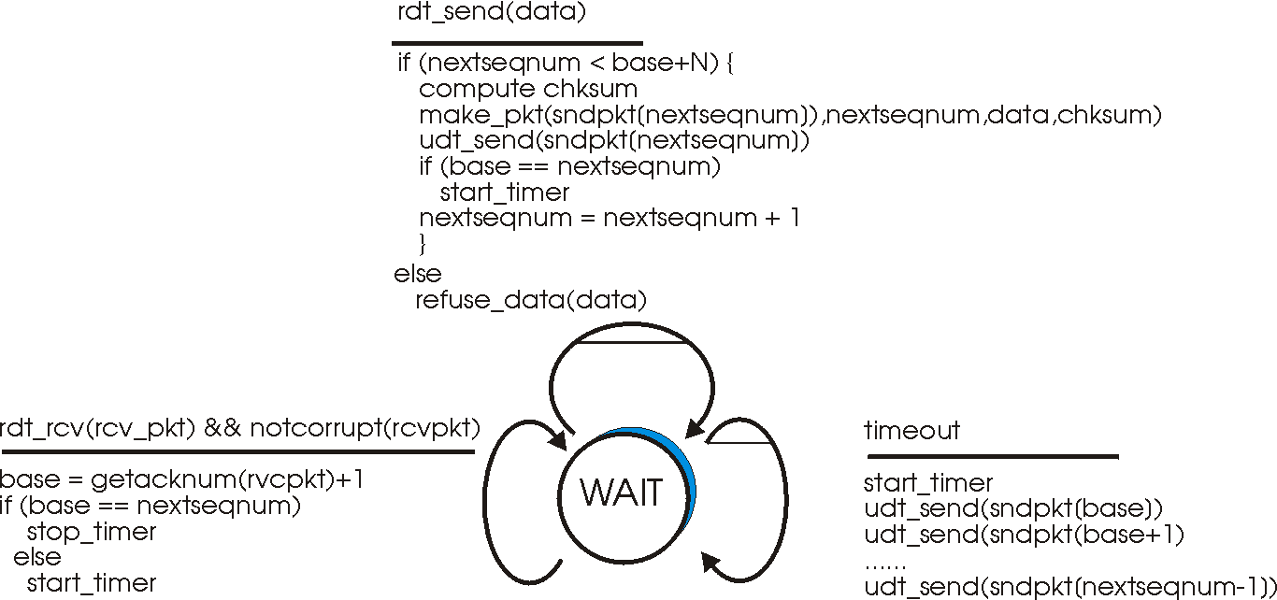
GBN: sender extended FSM

Slide 31
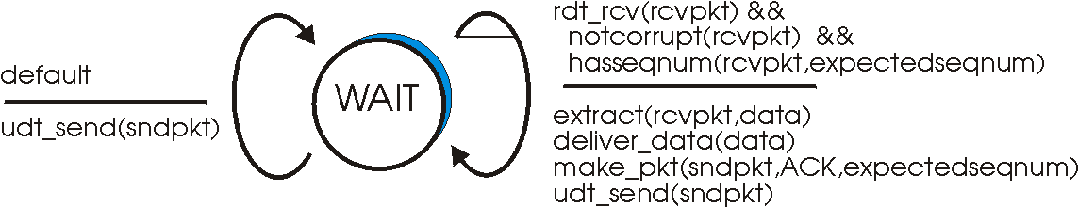
GBN: receiver extended FSM
receiver simple:
ACK-only: always send ACK for correctly-received pkt with highest in-order seq #
  may generate duplicate ACKs
  need only remember expectedseqnum
out-of-order pkt:
  discard (don’t buffer) -> no receiver buffering!
  ACK pkt with highest in-order seq #

Slide 32

GBN in action

Slide 33
Selective Repeat
receiver individually acknowledges all correctly received pkts
  buffers pkts, as needed, for eventual in-order delivery to upper layer
sender only resends pkts for which ACK not received
  sender timer for each unACKed pkt
sender window
  N consecutive seq #’s
  again limits seq #s of sent, unACKed pkts

Slide 34

Selective repeat: sender, receiver windows

Slide 35
Selective repeat
sender
receiver
data from above :
if next available seq # in window, send pkt
timeout(n):
resend pkt n, restart timer
ACK(n) in [sendbase,sendbase+N]:
mark pkt n as received
if n smallest unACKed pkt, advance window base to next unACKed seq #
pkt n in [rcvbase, rcvbase+N-1]
send ACK(n)
out-of-order: buffer
in-order: deliver (also deliver buffered, in-order pkts), advance window to next not-yet-received pkt
pkt n in [rcvbase-N,rcvbase-1]
ACK(n)
otherwise:
ignore

Slide 36
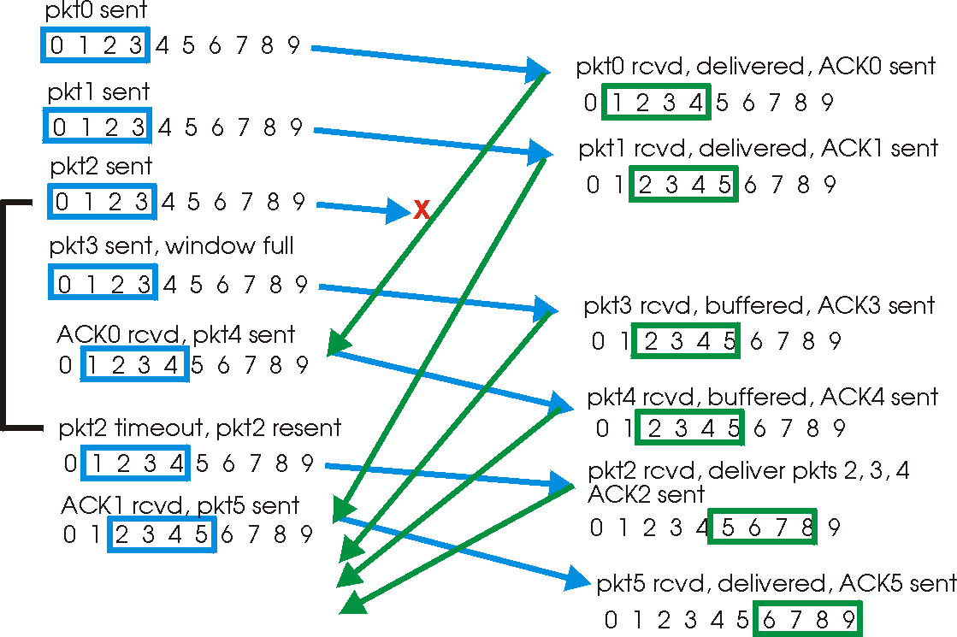
Selective repeat in action

Slide 37

Selective repeat: dilemma
Example:
seq #’s: 0, 1, 2, 3
window size=3
receiver sees no difference in two scenarios!
incorrectly passes duplicate data as new in (a)
Q: what relationship between seq # size and window size?

